Slide 1
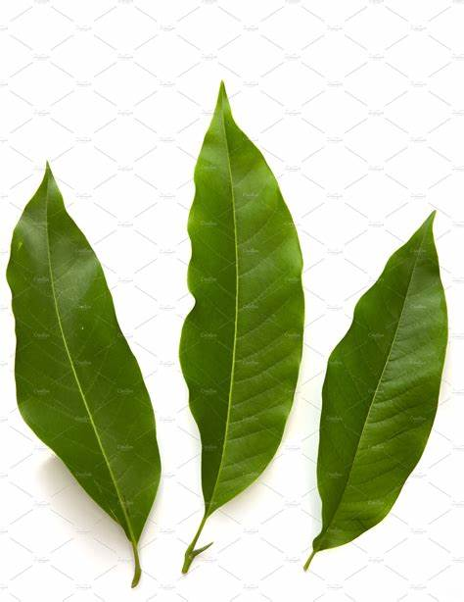
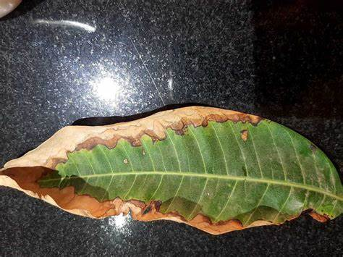

MANGO LEAF DISEASE DETECTION
Under the Guidance (Mentor) of
Aishwarya Saxena
By:- Sumit Kumar
BTech CSE 2nd Year
Manipal University Jaipur
Notes:
Good morning My Name is Sumit Kumar I am pursuing Btech in Cse from Manipal University Jaipur. I have created this project for mango leaf disease detection using machine learning under the guidance of Mrs. Aishwarya Saxena ma’am.

Slide 2
Index
SR. No | TOPIC | PAGE NO
1 | INTRODUCTION | 3
2 | OBJECTIVES | 4
3 | BACKGROUND | 5
4 | HARDWARE AND SOFTWARE REQUIREMENT | 8
5 | FUTURE SCOPE | 9
6 | CONCLUSION | 10
7 | BIBLIOGRAPHY AND REFERENCES | 11
Notes:
In this presentation I have created the method and modules used for developing the system

Slide 3
MANGO LEAF DISEASE DETECTION
INTRODUCTION
Mango is one of the most widely cultivated fruits in the world, with millions of hectares of land dedicated to its cultivation. However, various diseases often threaten mango production that can significantly reduce yields and crop quality. Early detection and management of these diseases are crucial for maintaining healthy mango orchards and ensuring good yields.
Machine learning techniques have emerged as a powerful tool for the detection of plant diseases. These techniques can analyze images of plants’ leaves and accurately identify the presence of specific diseases, even in the early stages. With the ability to process large amounts of data quickly and accurately, machine learning models can help farmers detect diseases in their orchards more efficiently and effectively.
The use of computer vision and machine learning techniques can enable the automatic detection of mango diseases from leaf images, this can help farmers and researchers to improve the efficiency and accuracy of disease detection and management, leading to better crop yields and quality.
Machine learning-based mango leaf disease detection systems are designed to automatically analyze images of mango leaves and identify the presence of specific diseases. These systems can be integrated into mobile applications or web platforms and made accessible to farmers and researchers, helping them to quickly and accurately detect diseases in their orchards.
Notes:
As we all know that India is the largest producer of mango with a production of over 18 million tons, which is approximately 50% of the global mango supply. So there is a great use for this system so that the quality of the goods produced can be improvised. Machine learning-based mango leaf disease detection systems are designed to automatically analyze images of mango leaves and identify the presence of specific diseases. These systems can be integrated into mobile applications or web platforms and made accessible to farmers and researchers, helping them to quickly and accurately detect diseases in their orchards.

Slide 4
Objective
The objective of a mango leaf disease detection project using machine learning is to develop a system that can accurately and efficiently detect the presence of diseases in mango leaves. The system should be able to analyze images of mango leaves and identify the presence of diseases, even in the early stages, in order to aid in the management and control of the diseases.
Some specific objectives of the project could include:
Developing a machine learning model that can accurately distinguish between healthy and diseased mango leaves based on visual features.
Creating a dataset of images of mango leaves, both healthy and diseased, to train and evaluate the model.
Evaluating the performance of the model using various metrics such as accuracy, precision, and recall.
Implementing the model in a mobile or web-based application that is accessible to farmers and researchers.
Testing the system on real-world data to ensure its reliability and effectiveness.
Improving performance using techniques such as transfer learning, data augmentation, etc.
Overall, the goal of the project is to create a system that can help farmers and researchers detect mango leaf diseases more efficiently and effectively, leading to better crop yields and quality.
Notes:
. This can be done by humans as well but when workload increases there are many chances that human may neglect or ignore some minor details that may lead to poor diagnosis. So The objective of this project using machine learning is to develop a system that can accurately and efficiently detect the presence of diseases in mango leaves

Slide 5
Background
Computer vision and machine learning techniques have been widely used to detect and diagnose plant diseases. These techniques can be used to extract features from the images of the plant leaves, such as color, texture, and shape, that can be used to distinguish between healthy and diseased leaves. The use of machine learning-based mango disease detection systems can help farmers and researchers to improve the efficiency and accuracy of disease detection and management, leading to better crop yields and quality. There are several Python modules that can be used for a mango leaf disease detection project using machine learning. Some of the most commonly used modules include:
TensorFlow: TensorFlow is an open-source machine learning library that can be used to train and deploy machine learning models. It provides a wide range of tools for building and training neural networks, including support for convolutional neural networks (CNNs), which are commonly used for image classification tasks.
Keras: Keras is a high-level neural networks API, written in Python and capable of running on top of TensorFlow. It allows for easy and fast prototyping and supports convolutional, recurrent, and other neural network architectures.
OpenCV: OpenCV is an open-source computer vision library that can be used for image processing tasks, such as reading, writing, and displaying images, as well as for feature extraction, such as edge detection and object recognition.
Scikit-learn: Scikit-learn is a machine-learning library for Python that provides simple and efficient tools for data mining and data analysis. It can be used for various machine-learning tasks such as classification, regression, and clustering.
Notes:
The modules that I have used are tensorflow i.e an open source machine learning library that can be used to train and deploy machine learning models, keras it is a high level neural network, and it allows for easy and fast prototyping and convolutional architecture, opencv It is a library used for image processing and object recognition, scikit learn It is used for data mining and data analysis,

Slide 6
Pandas: Pandas is a library for data manipulation and analysis. It provides data structures and data analysis tools for handling and manipulating numerical tables and time series data.
Numpy: NumPy is a library for the Python programming language, adding support for large, multi-dimensional arrays and matrices, along with a large collection of high-level mathematical functions to operate on these arrays.
Matplotlib: Matplotlib is a plotting library for the Python programming language and its numerical mathematics extension NumPy. It provides an object-oriented API for embedding plots into applications using general-purpose GUI toolkits like Tkinter, wxPython, Qt, or GTK.
"Mango leaf diseases dataset" by A. K. Singh and A. K. Verma. This dataset contains images of mango leaves affected by various diseases, such as powdery mildew, rust, and bacterial black spot. The dataset is publicly available on the Kaggle platform.
These modules provide a wide range of tools for developing a mango leaf disease detection system using machine learning, including support for image processing, feature extraction, and model training and evaluation. Mango leaf disease detection typically works by using machine learning algorithms to automatically classify images of mango leaves as healthy or diseased based on their visual characteristics. Here is a more detailed overview of the process:
Image acquisition: This is the first step of the process, where images of mango leaves are acquired, either by taking photographs of the leaves or by collecting existing images from online sources. These images are used to train and test the machine-learning model.
Pre-processing: The next step is to pre-process the images to make them suitable for analysis. This can include image segmentation to isolate the leaves in the images and then using feature extraction techniques to extract color, texture, shape, and other information. Image pre-processing can also include techniques like cropping, resizing, and normalizing the images to make sure that the model can handle the images properly.
Feature Extraction: In this step, features are extracted from the images using various image processing techniques. These features can include color histograms, texture analysis, shape analysis, and other information that can be used to distinguish between healthy and diseased leaves.
Notes:
Pandas, matplotlib, numpy, and several datasets that are available on the network. The process that are involved in this system is Image acquisition and preprocessing of image using modules, feature extraction data mining and analysis

Slide 7
Model Training: Once the features have been extracted, a machine learning model is trained using the labeled data. This can be a supervised learning algorithm such as a decision tree, random forest, or neural network. For complex task, deep learning models like CNNs are used to learn features automatically from the images.
Model Evaluation: The trained model is then evaluated on a separate dataset, called the testing set, to measure its performance in terms of accuracy, precision, recall, and F1 score. This step is important to validate the model's ability to generalize to unseen data.
Model Deployment: Once the model has been trained and evaluated, and its performance is satisfactory, it can be deployed to classify new images of mango leaves as healthy or diseased. The model can be integrated into a mobile application or a web portal, making it easy for farmers or researchers to use in the field.
Mango leaf disease detection can be implemented using various machine learning algorithms, such as supervised learning algorithms, deep learning algorithms, and ensemble methods.
Supervised Learning Algorithms: These algorithms are trained on labeled data, which consists of a set of input features and corresponding output labels.
Decision Trees: Decision trees are a type of tree-based model that can be used to classify data based on a set of rules. They can handle both categorical and numerical data, and they are easy to interpret.
Random Forest: Random Forest is an ensemble method that combines multiple decision trees to improve the overall performance of the model. It works by averaging the predictions of individual trees to reduce overfitting and improve generalization.
Support Vector Machines (SVMs): SVMs are a type of linear classifier that separates data into different classes using a hyperplane. They are particularly useful when the data is not linearly separable.
Notes:
Then model training evaluation and deploymen.

Slide 8
Hardware and Software Requirements
Hardware Requirement (Minimum) | Software Requirement (Minimum)
64-bit CPU (Intel / AMD) | Linux- Ubuntu 16.04 to 17.10, or Windows 7 to 11
5GB Free disk space | CPU clock rate 1.3 GHz (2.8 GHz preferable)
14-inch display (15 inches preferable) | Intel i3 Processor (Intel i5 preferable)
4GB RAM (8GB preferable) | Python 3.6 and related packages upto 3.9 over jupyter notebook
Notes:
Hardware and software requirements for the system to run are as metioned in the table i.e. 64 bit processor free space over disk upto 5 gb 14 inch display for better understanding 4 gb ram for quick processiong with windows 7 to 11 cpu clock rate of 1.3Ghz intel i3 processor and python upto 3.9 with jupyter note book and all the above mentioned modules installed

Slide 9
Future Scope
There are several areas where the mango leaf disease detection project using machine learning and Python can be further developed and expanded in the future. Some possible areas of future research include:
Improving the accuracy of the model by using more advanced machine learning techniques such as deep learning, which can learn hierarchical representations of images and detect patterns that are not visible to human eyes.
Incorporating additional data sources, such as weather and climate data, to improve the model's ability to detect diseases in different conditions.
Developing real-time monitoring systems that can automatically analyze images of mango leaves as they are captured, rather than relying on pre-existing images.
Developing a system for automatic disease management and control, for example, by providing recommendations for treatment based on the type of disease detected.
Developing a multi-class classifier to detect and predict multiple diseases at once.
Improving the performance of the model by using transfer learning techniques and fine-tuning pre-trained models on the mango dataset
Notes:
The future scope of the mango leaf disease detection project using machine learning is very promising. As the technology and algorithms continue to improve, it is expected that the accuracy and efficiency of the disease detection system will continue to increase. This can lead to the wider adoption of machine learning-based solutions for mango disease detection in the farming industry, helping to ensure the health and productivity of mango crops on a larger scale.

Slide 10
Conclusions
In conclusion, the mango leaf disease detection project using machine learning is a valuable tool for improving the efficiency and accuracy of disease detection and management in mango orchards. The project involves the use of computer vision and machine learning techniques to analyze images of mango leaves and identify the presence of specific diseases. By using these techniques, the project can aid farmers and researchers in detecting diseases in their orchards more efficiently and effectively, leading to better crop yields and quality.
The project involved several steps, including data collection, data pre-processing, feature extraction, model training, and model evaluation. Python modules like TensorFlow, Keras, OpenCV, Scikit-learn, Pandas, Numpy, and Matplotlib were used to develop the project.
Notes:
In conclusion we can say that the mango leaf disease detection project using machine learning is a valuable tool for improving the efficiency and accuracy of disease detection and management in mango orchards

Slide 11
References and Bibliography
"A review on the use of computer vision for plant disease detection" by W. L. L. Pinheiro and L. A. de Almeida. This article reviews the use of computer vision techniques for plant disease detection.
"Machine learning-based detection of plant diseases" by M. S. G. Khokhar, T. A. Khan, and M. Iqbal. This article provides an overview of the use of machine-learning techniques for plant disease detection.
"Deep learning for plant disease diagnosis: a review" by A. K. Singh, R. K. M. S. Rana, and A. K. Verma. This article reviews the use of deep learning techniques for plant disease diagnosis.
"Mango leaves dataset" by P. J. Joseph and T. R. S. R. Reddy. This dataset contains images of mango leaves affected by various diseases, such as powdery mildew, rust, and anthracnose. The dataset is publicly available on the Kaggle platform.
Notes:
The refrences that I have used are from Kaggle platform, Scikit-learn and UCI For datasets and better understanding of disease.

